Slide 1

Zomato Order & Restaurant Analysis Using Power BI

Slide 2
Problem Statement:
Analyze and visualize Zomato’s restaurant and order data to uncover trends in customer preferences, restaurant performance, pricing impact, and location-based insights. The goal is to transform raw data into actionable business intelligence for decision-making.

Slide 3

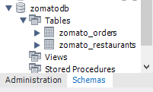

Task 1: Upload Dataset into MySQL
Created a new database named ZomatoDB. Imported the provided CSV 2 datasets :Restaurants & Orders.
Insights:
Data types were not set correctly during import, so manual updates were performed to assign proper types.
Notes:
Notes to presenter:
Description of what you learned in your own words on one side.
Include information about the topic
Details about the topic will also be helpful here.
Tell the story of your learning experience. Just like a story there should always be a beginning, middle and an end.
On the other side, you can add a graphic that provides evidence of what you learned.
Feel free to use more than one slide to reflect upon your process. It also helps to add some video of your process.

Slide 4
Task 2: Perform Simple Data Transformations Using SQL
Insights:
To perform data cleaning process: I have verified for any potential duplicate records — none were found. Checked all columns for missing values, No NULL values detected in the datasets, ensuring clean input for further analysis
Data Exploration Queries: While checking the count of restaurants are there in each city using the query we got to know out of five cities 'Mumbai’ have the most restaurants '115’. Also, had the highest number of orders ‘3,384’ and top revenue-generating restaurants

Slide 5
Data Aggregation: while calculating the average order amount for each city, we knew that Chennai has the highest average order value at approximately ₹1,041.
Joins: Combined two tables and created a dataset, export the joined dataset for use in Power BI analysis.

Slide 6
Task 3: Power BI Analysis and Visualization
Imported the transformed Excel dataset (from the SQL join) into Power BI.
Ensuring accurate data types is essential for correct calculations and clean visualizations in Power BI and removed unwanted columns
Since the SQL join was already performed before exporting the Excel file, all restaurant and order information resides in a single dataset. Therefore, no relationship modeling was required in Power BI.

Slide 7

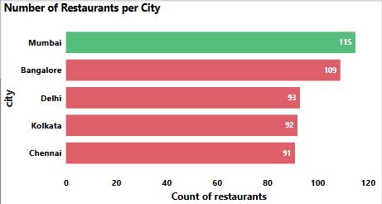
Power BI tasks
Task 1: Number of Restaurants per City
Insights:
  Mumbai leads in restaurant count 115, reflecting high market activity
  Chennai, Delhi and Kolkata have fewer restaurants — indicating potential for business development.
We have to expand restaurant partnerships in cities like Chennai, Kolkata, and Delhi to match demand and competitor activity.

Slide 8
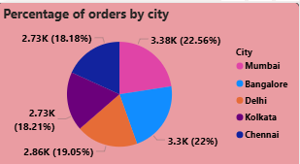
Task 2: Percentage of Orders from Different Cities
Insights:
Mumbai leads the Zomato order market, contributing 22.56% the highest share among all cities, indicating strong demand. Bangalore follows closely behind.
Kolkata (18.21%) and Chennai (18.18%) show relatively lower order percentages.
To improve engagement, Zomato should boost marketing campaigns in mid-tier cities. Collaborating with local influencers and food bloggers can help attract more users.

Slide 9
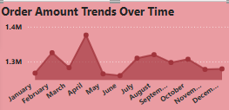
Task 3: Order Amount Trends Over Time
Insights:
  April records the highest total order cost, likely due to school holidays or seasonal demand.
  February shows a secondary peak, potentially driven by festival period.
Launch targeted campaigns based on user location, cuisine preferences, and price sensitivity. Also, we can give reward points on every order in nonpeak times to encourage business.

Slide 10
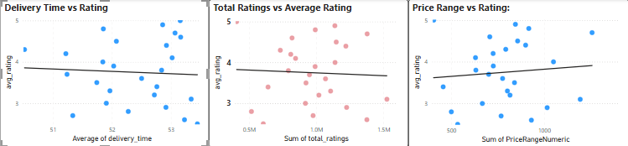
Task 4: Correlation of Factors Affecting Average Rating
Insights :
Delivery Time vs Rating: Slight negative correlation — faster delivery doesn't always mean higher ratings.
Total Ratings vs Average Rating: Negative correlation — restaurants with a large number of reviews often receive slightly lower average ratings, possibly due to a broader range of customer experiences.
Price Range vs Rating: Slight positive correlation — higher prices often align with better ratings and premium service.

Slide 11
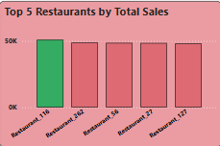
Task 5: Top 5 Restaurants by Total Sales
Insights :
  Restaurant 116 have higher prices, which contributes to the higher total sales.
  Some restaurants charge premium prices for their menu items, leading to higher total sales even if the number of orders is moderate.
What drives their success? Key drivers behind their success could include pricing strategy, delivery performance, customer reviews, or strategic location.

Slide 12
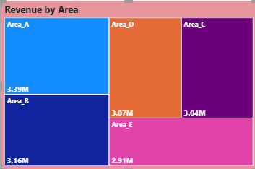
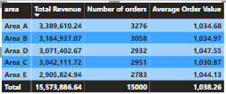
Task 6: Revenue by Area Using a Tree Map
Insights :
  Area A (₹3.39M) emerge as the top revenue-generating area and Area E (₹2.91M) shows the lowest revenue contribution.
  While Area A has the highest total revenue, but its average order value (₹1,034.80) is slightly lower than that of Area D. This shows that revenue in Area A is driven more by a higher volume of orders, whereas Area D generate higher revenue per order.
Zomato could explore replicating high order value strategies from Area D in higher-volume zones like Area A for greater profitability

Slide 13
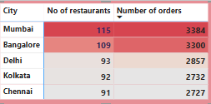
Task 7: Order Density by City Using a Heat Map
Insights:
The heat map shows Mumbai leading with the highest number of orders, followed closely by Bangalore and Delhi. However, when comparing the number of restaurants to orders, all cities show a consistent average of around 30 orders per restaurant.
This suggests a healthy balance between supply and demand in major cities.

Slide 14

Task 8: KPI Cards – Total Revenue & Average Order Value
Insights:
These KPI cards give a quick view of business performance. The total revenue from all orders is 15.57M, and the average order value period over period spends per order below
.

Slide 15
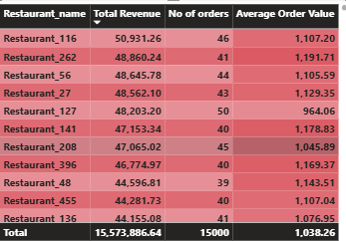
Task 9: Restaurant-Wise Sales Summary in a Table
Insights:
Top-performing restaurants generate significantly higher revenue and order volume likely due to high traffic locations, popular cuisine, or loyal customers.
We can use this table to identify restaurants that need performance improvement.
By using the filter the table by city or price range to adjust marketing and delivery strategies locally.

Slide 16
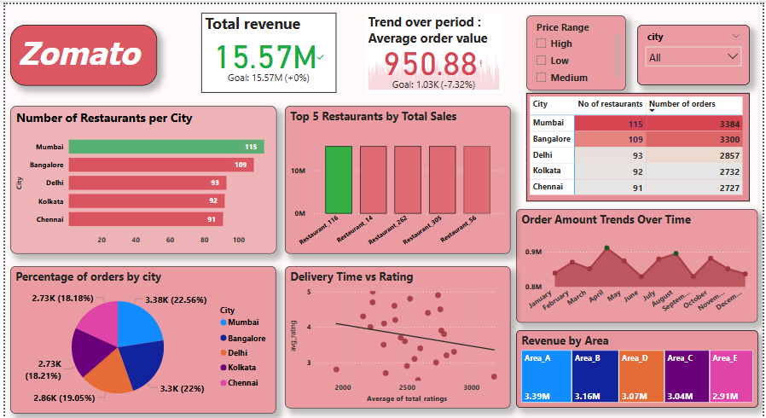
Task 10: Power BI Dashboard – Combining All Visuals
Insights:
This analysis uncovers key factors into Zomato’s restaurant performance, customer ordering trends, and factors influencing customer ratings.
Also, the findings highlight top-performing cities, seasonal demand patterns, and correlations between price, delivery, and customer satisfaction, leading to actionable strategies for growth and service optimization."

